Slide 1
3D visualization of the electromagnetic field intensity distribution for UHF-RFID-identification
Garching bei Muenchen, April 2016
IDP Presentation
Morteza Mostajab

Slide 2
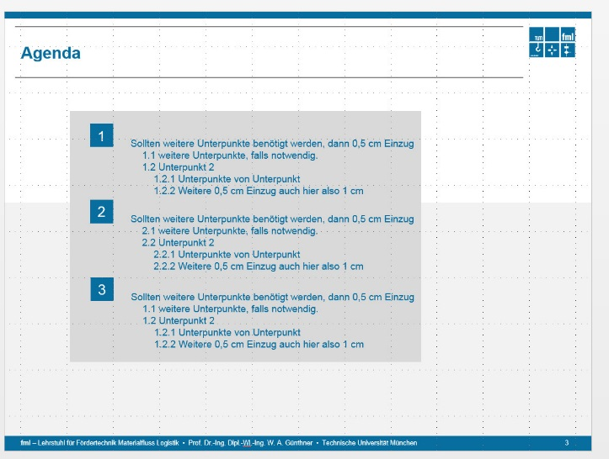
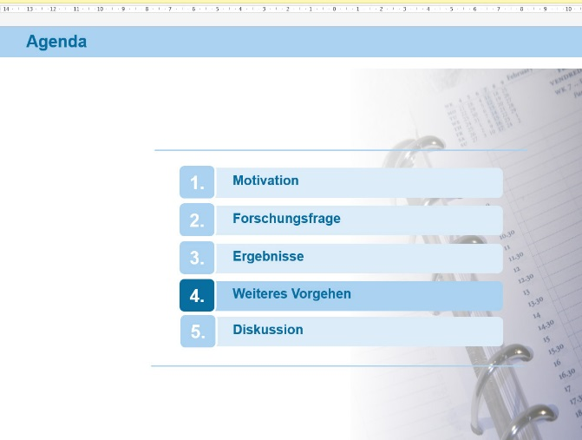
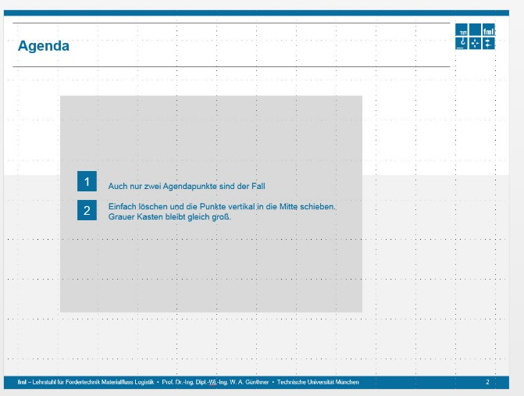
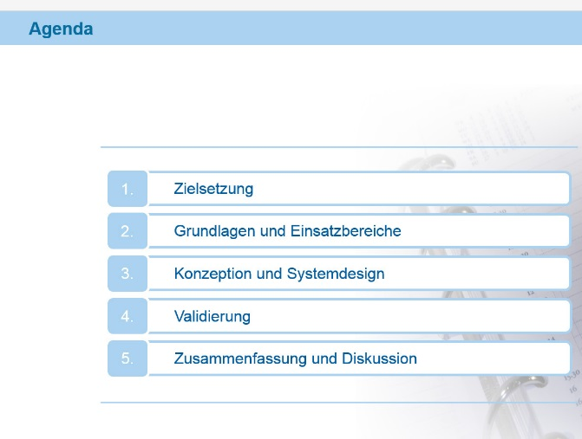
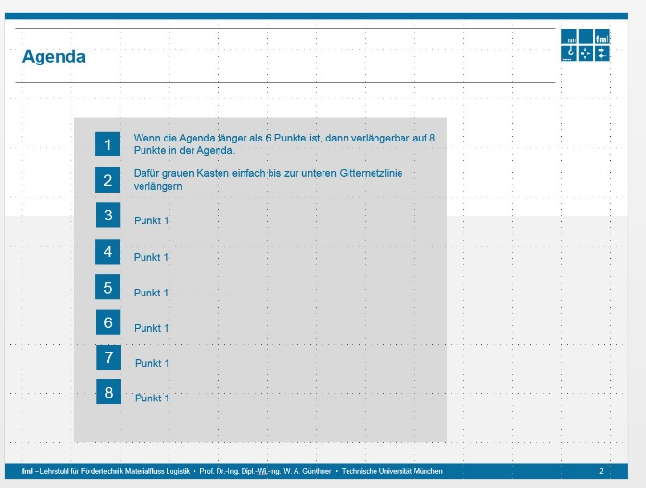
Agenda
1
Introduction
2
Problem Definition
Einheitliche Darstellung
3
Setting up the virtual world
4
Data Collection
5
Data Visualization
6
Results

Slide 3
Introduction
UHF-RFID-System demands reliable detection of transponders
A knowledge of the field strength distribution in an area of interest
Speeds up optimizing the installation
The general goal of the whole project:
Create a method and hardware to measure the field strength distribution.
Using a mobile device

Slide 4
Problem Definition
Building a model of examined installation in 3d virtual world.
Should be fast and intractable (Using tracking system).
Assist the user during measurement by specific visualization.
Make the measurement process faster.
Collect enough data for an accurate visualization.
Visualize collected data in different ways.
Investigate appropriate visualization methods.
To detect weak/strong parts of the environment.

Slide 5
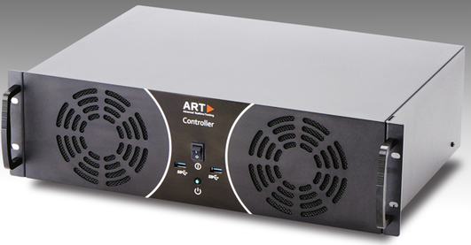
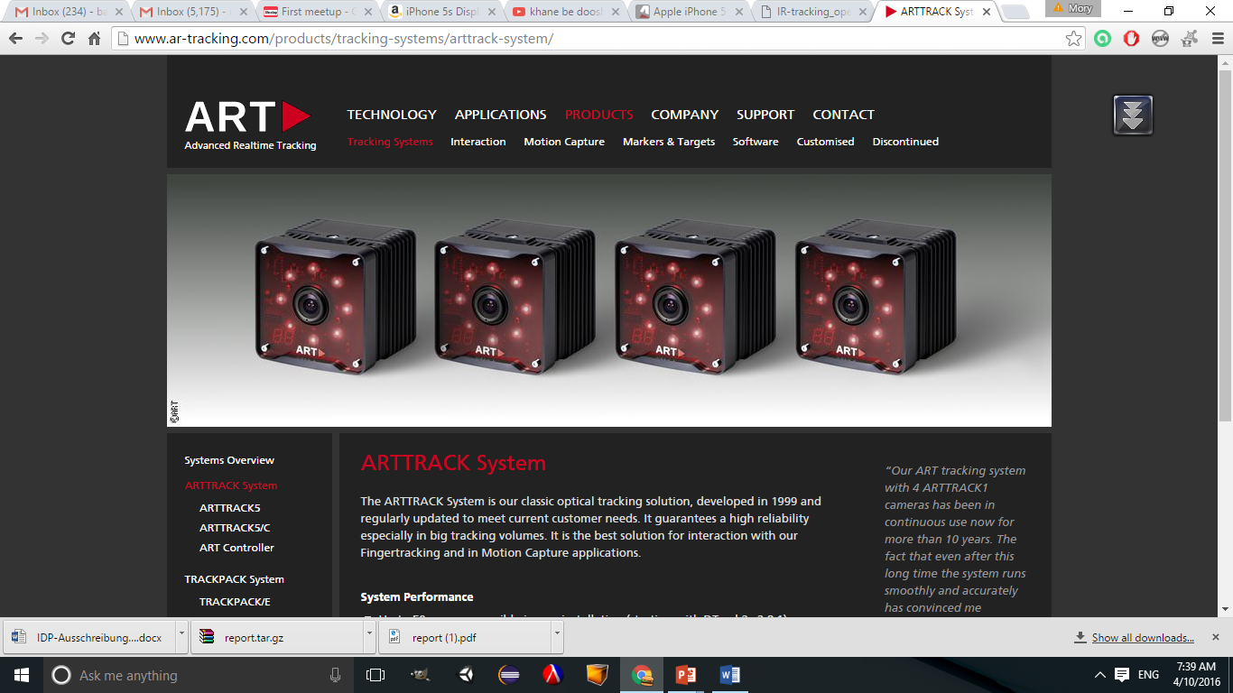
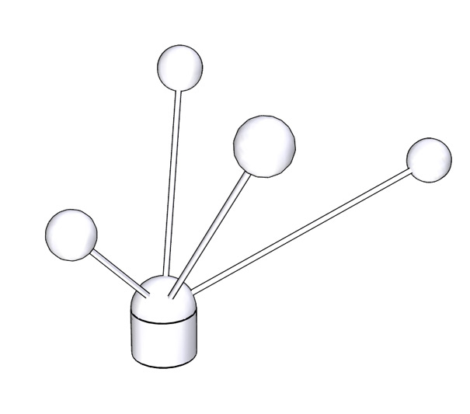
Tracking System
ART-Tracker
IR Flashes From Camera
IR Flashes From Camera

Slide 6
Tracking System
ART-Tracker
Reflected Light
Reflected Light

Slide 7
Tracking System
ART-Tracker
2D image data from camera
2D image data from camera

Slide 8
Tracking System
Marker Position
Intersection of optical rays
ART-Tracker

Slide 9
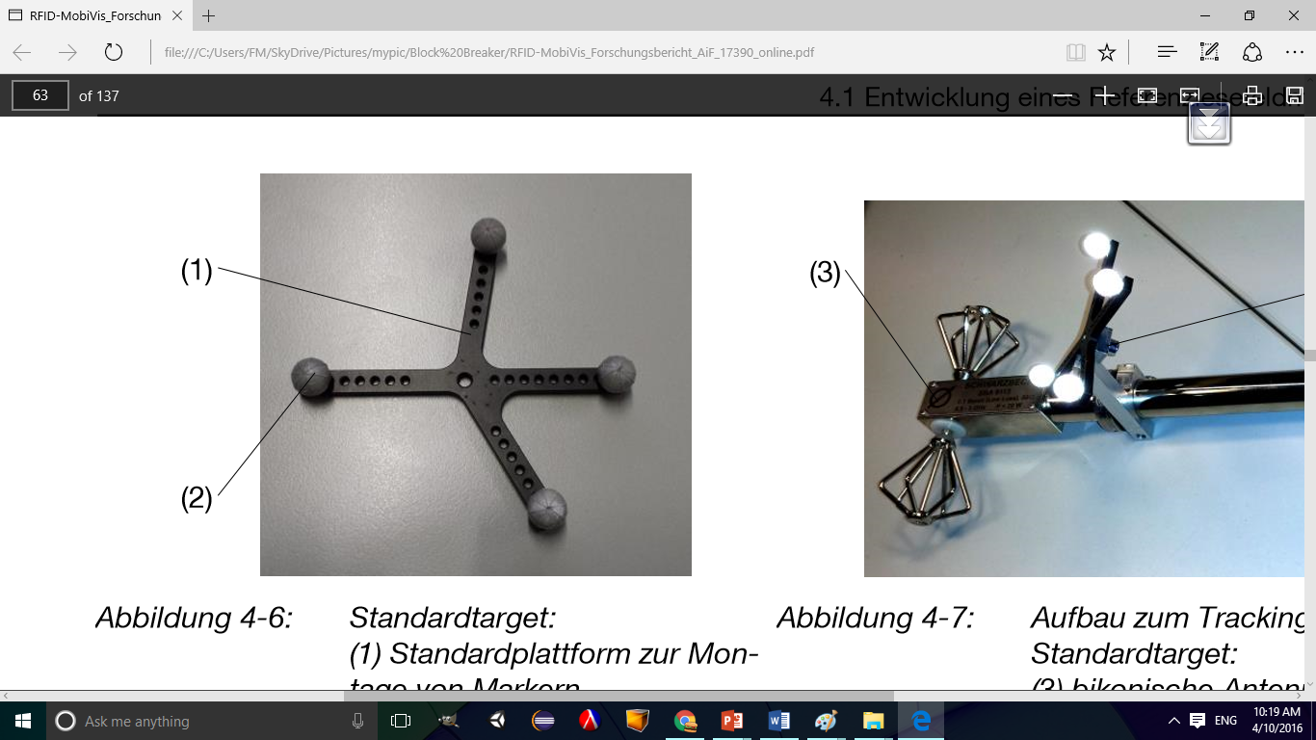
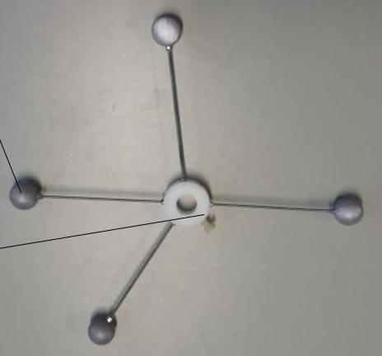
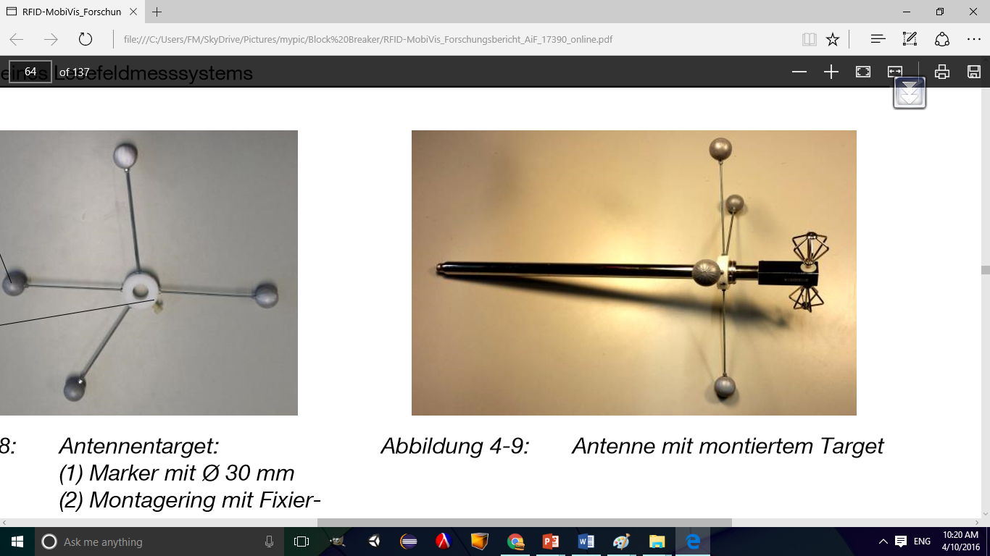
Markers
Coordinate System Origin Marker
Antenna Pose Marker
Dipole Tracking Marker

Slide 10
Setting up the virtual world
Requirements
Environment coordinate’s origin
Gate dimensions
UHF Antenna’s position and orientation
Defining these specifications:
Manually using mouse or keyboard.
Requires measurements
Hard to measure orientation and position accurately
Use a tracking system to detect them by processing the images.

Slide 11
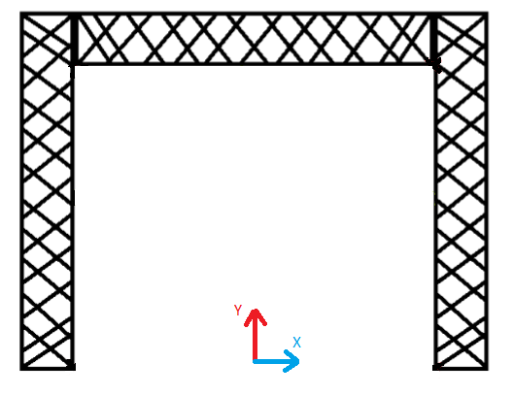
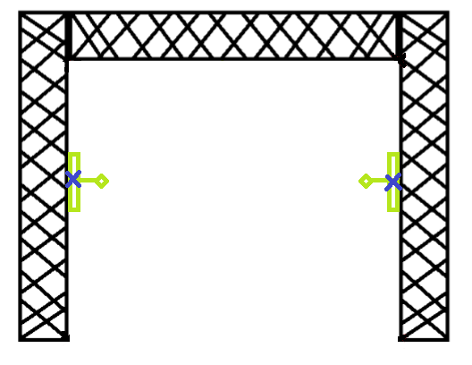
Setting up the virtual world
Defining environment coordinate system’s origin
Defining Antenna’s position and orientation
Defines the gate’s dimensions implicitly

Slide 12
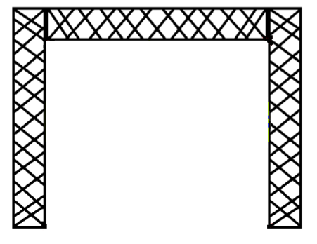

Gate Dimension Determination
w
w
w
h
h
h/2
h/2

Slide 13
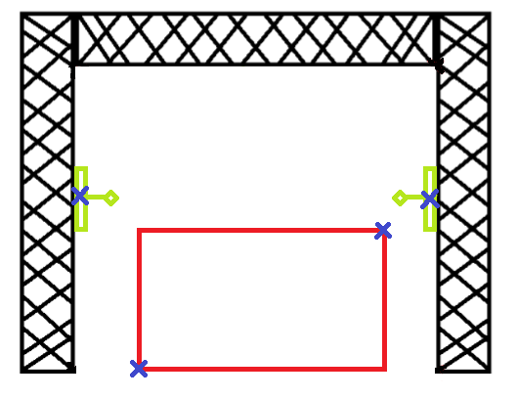
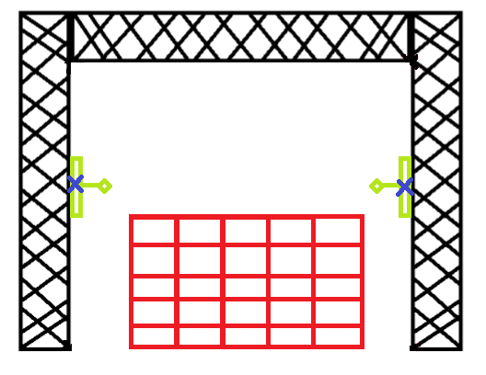
Data Collection
Area of interest is an axis-aligned bounding box which the magnetic field values in it is of interest.
Defining the area of interest:
Using dipole’s head to determine its min and max points.
Manually enter the area of interest resolution.

Slide 14
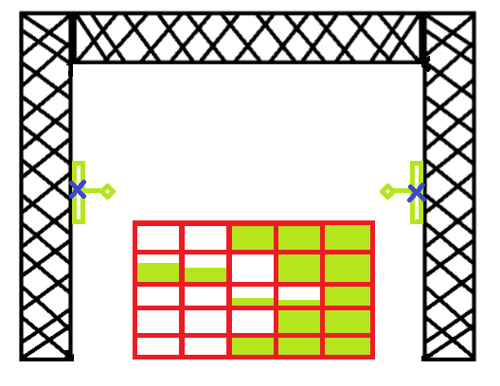
User Assistant During Data Collection
Progress bar per grid’s element

Slide 15
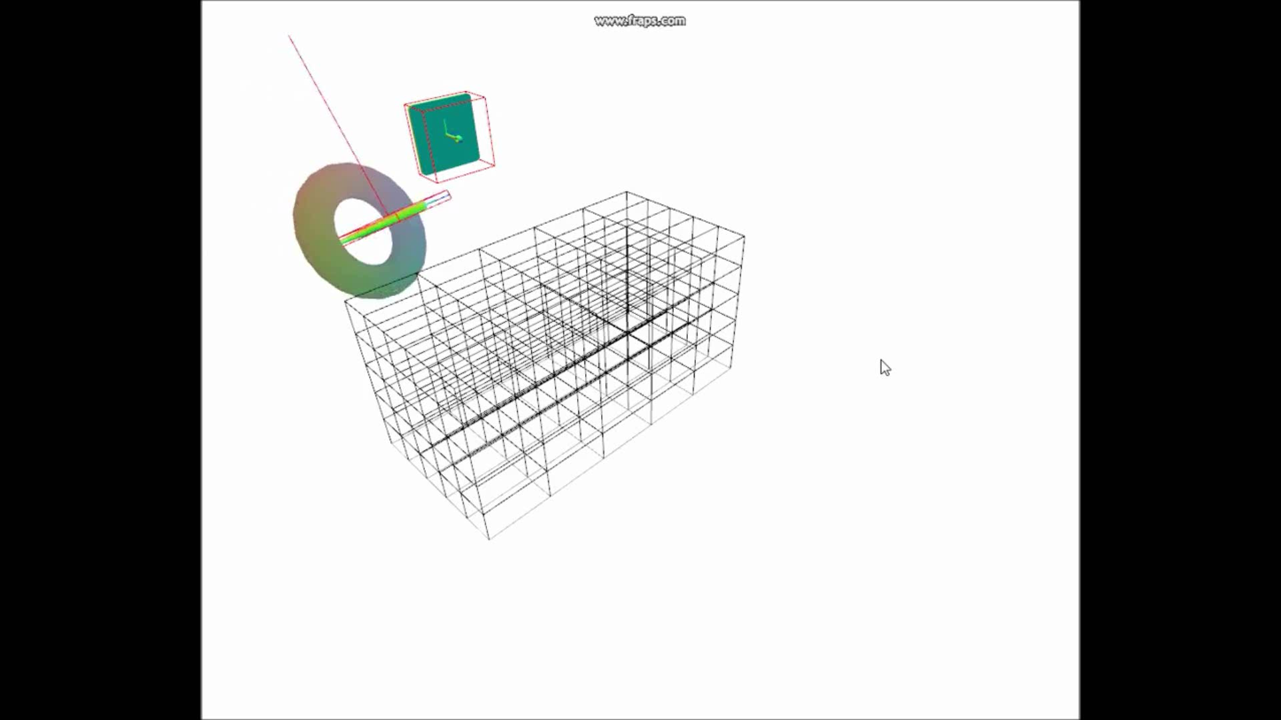
User Assistant During Data Collection

Slide 16
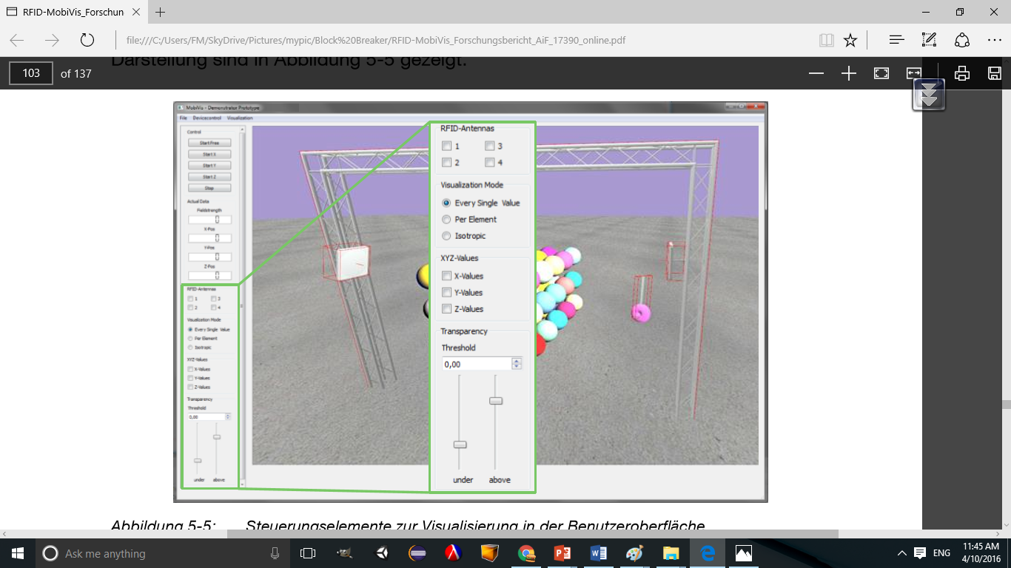
Data Visualization
Visualizing all collected data
Visualizing magnetic field magnitude
Visualizing grid elements
Visualizing the magnetic field volume

Slide 17
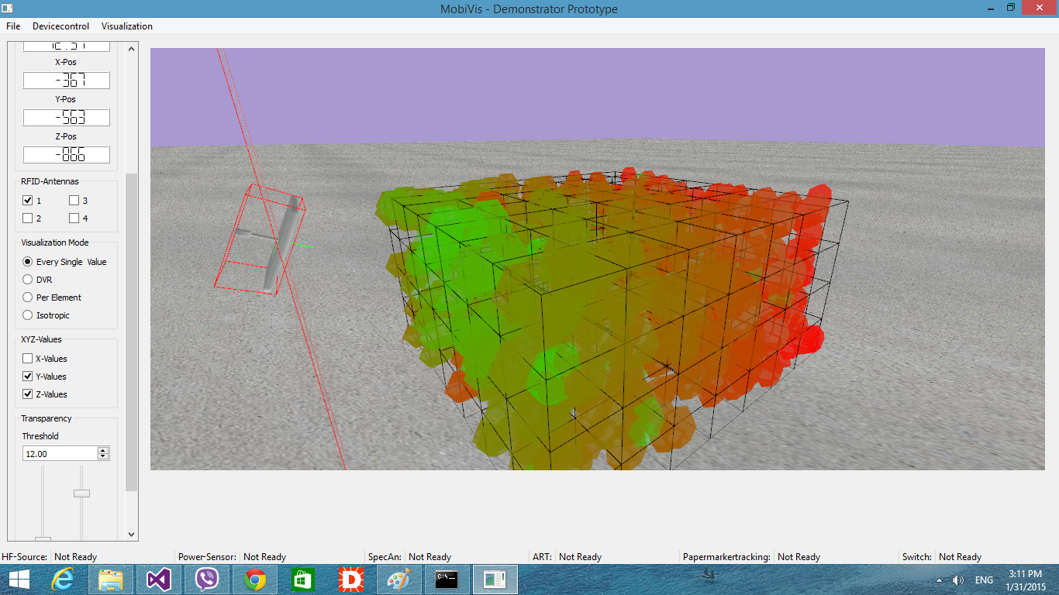
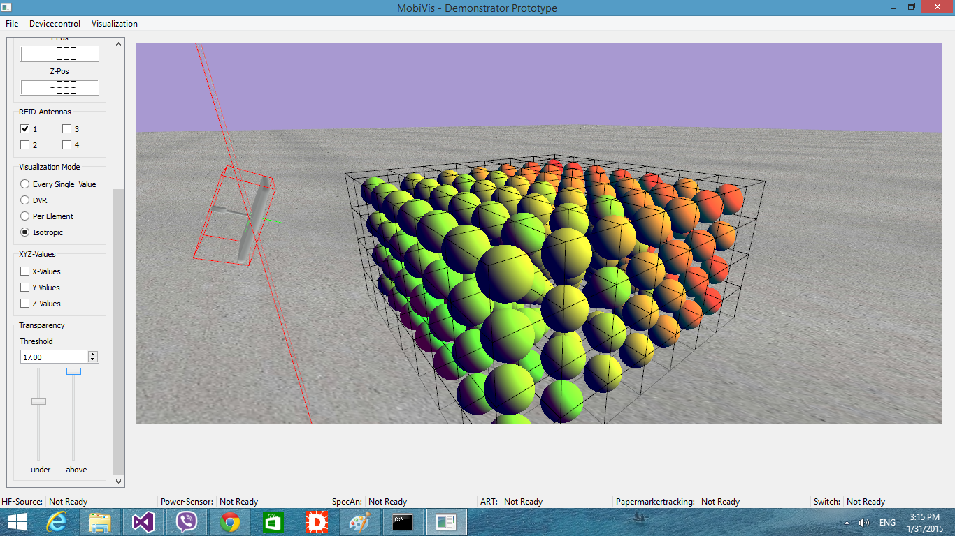
Torus/Sphere Glyph
Rendering high number of torus/spheres on GPU
Generating geometries on the GPU using geometry shader
Using higher order primitives method

Slide 18
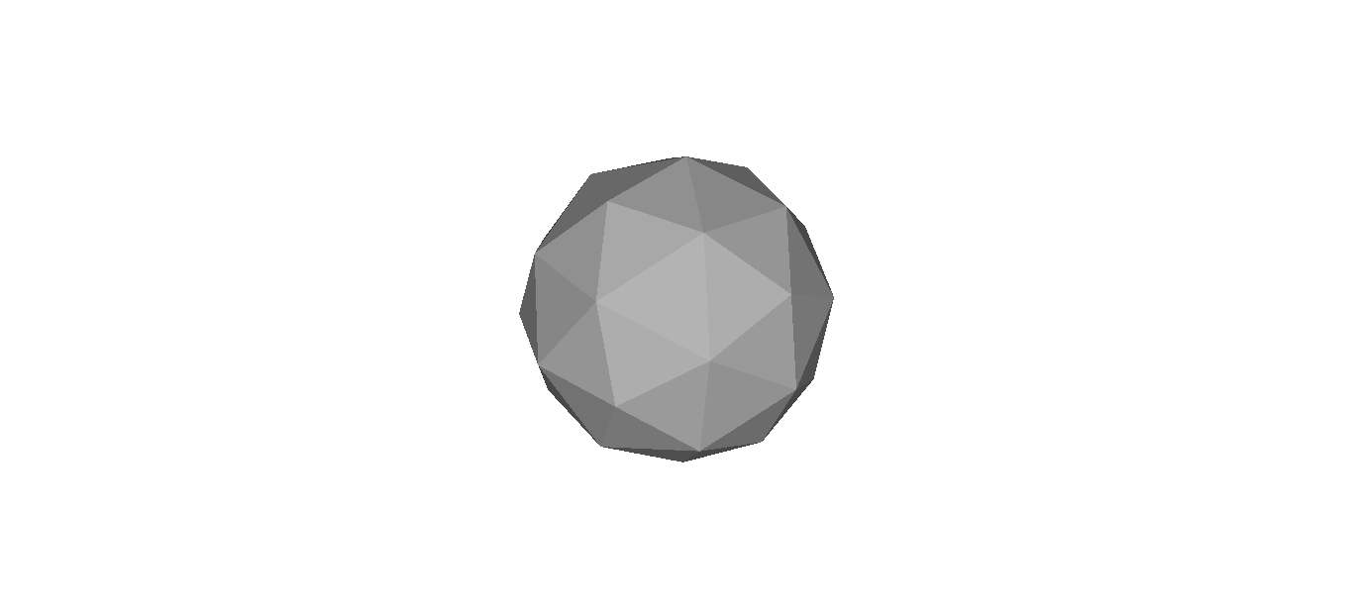
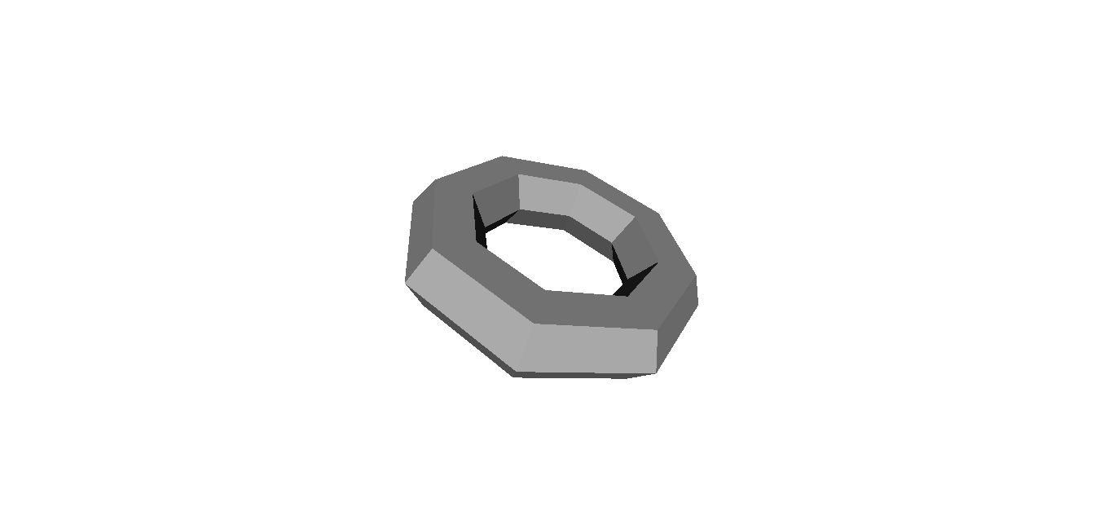
Torus/Sphere Glyph using Geometry Shader
Cons:
Not smooth -> Limitation in number of generated primitives and vertices.
Center + Radius
Geometry Shader
Center + Inner Radius + Outer Radius + Transformation
Geometry Shader

Slide 19
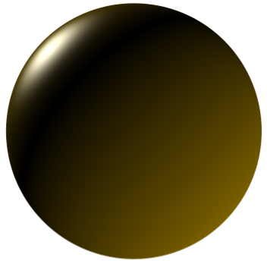
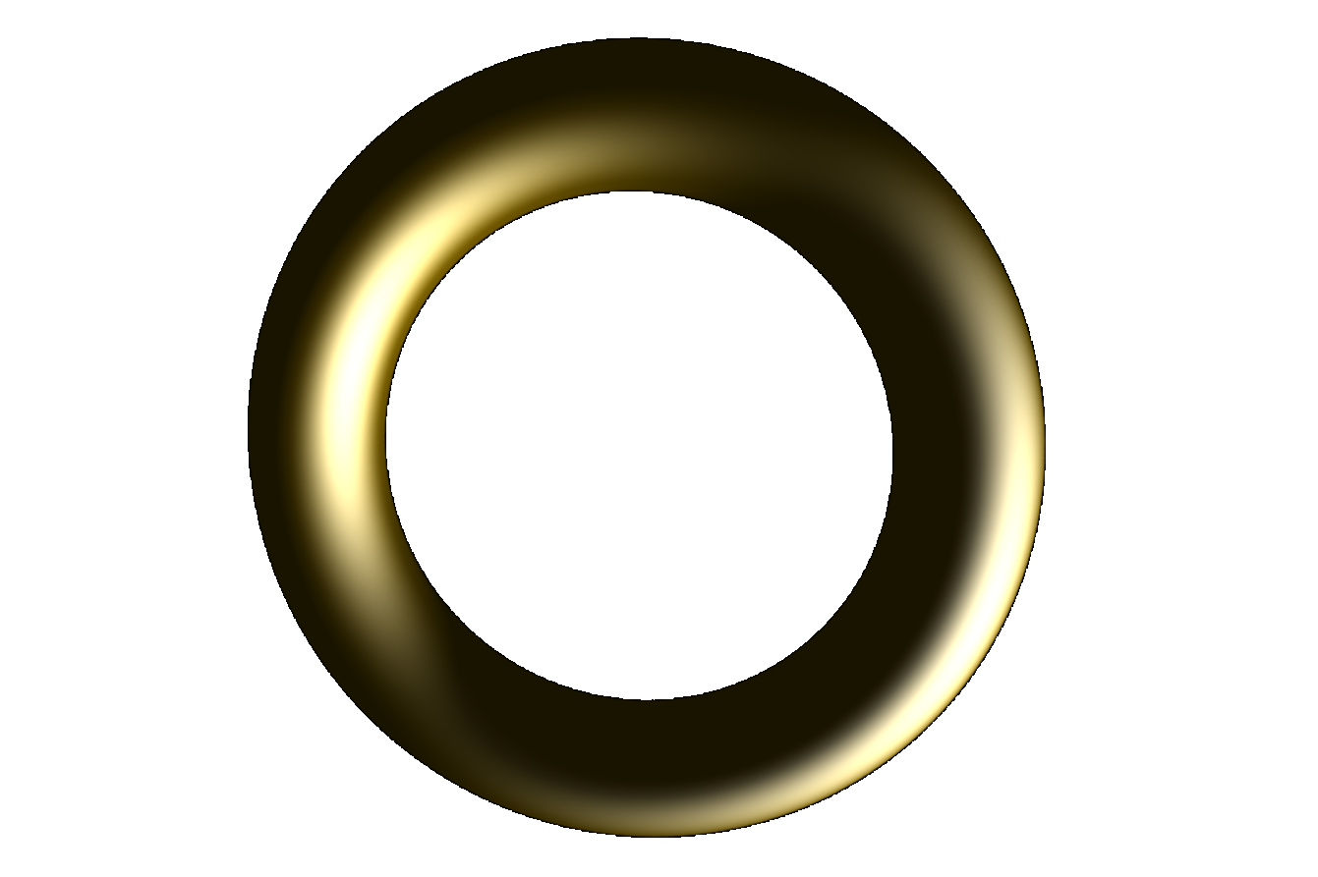
Torus/Sphere Glyph with Higher-Order Primitives (HOP)
Ray-casting sphere/torus:
Intersecting ray-sphere equation
Intersecting ray-torus equation:
Quartic Function
Requires double precision computation to reduce aliasing
Pros:
Pixel-Accurate Primitives

Slide 20
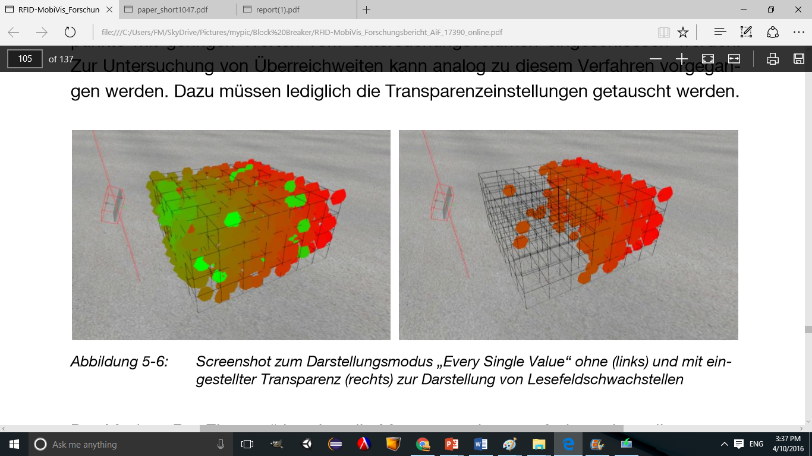
Transparency
Focus on part of dataset using transparency
Using two scrollbars to define transparency for weak/strong values
0.09

Slide 21
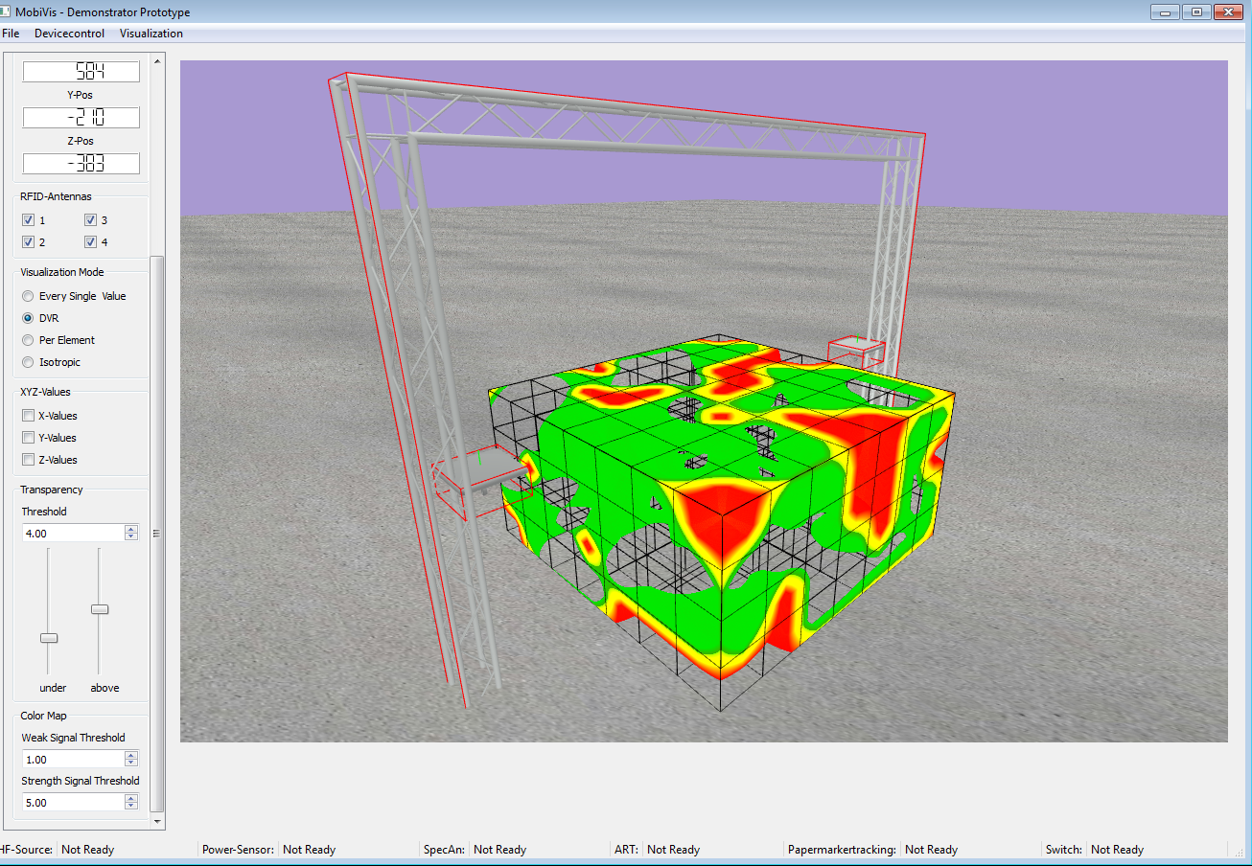
Direct Volume Rendering (DVR)
2D Projection of a 3D scalar field
Ray casting the volumetric data

Slide 22
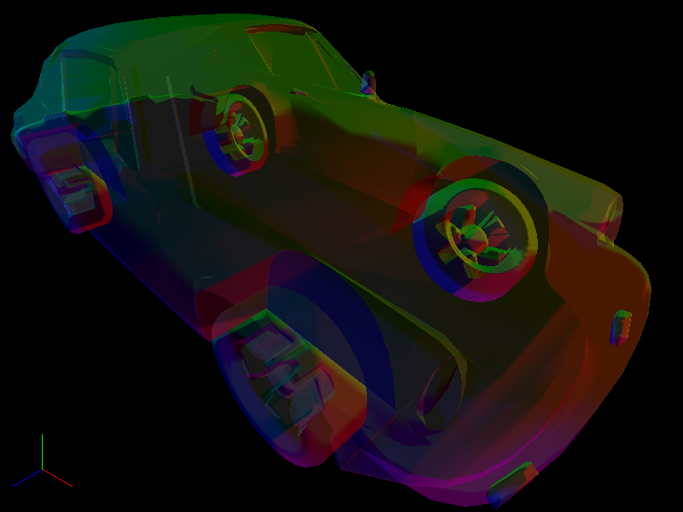
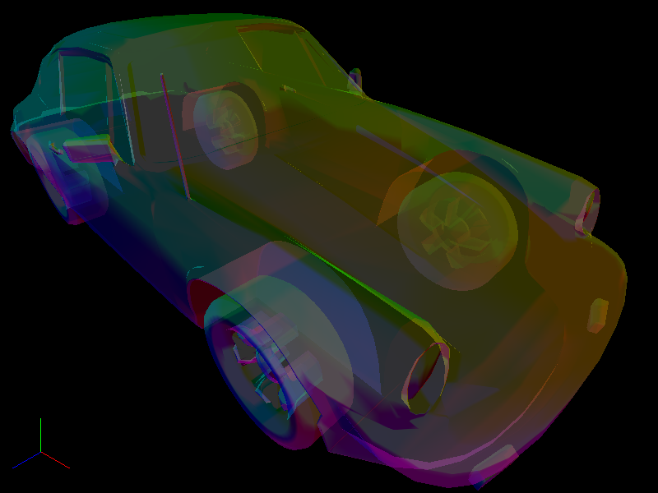
Future Works
Add Order Independent Transparency (OIT)
Wrong rendering order
Right rendering order

Slide 23
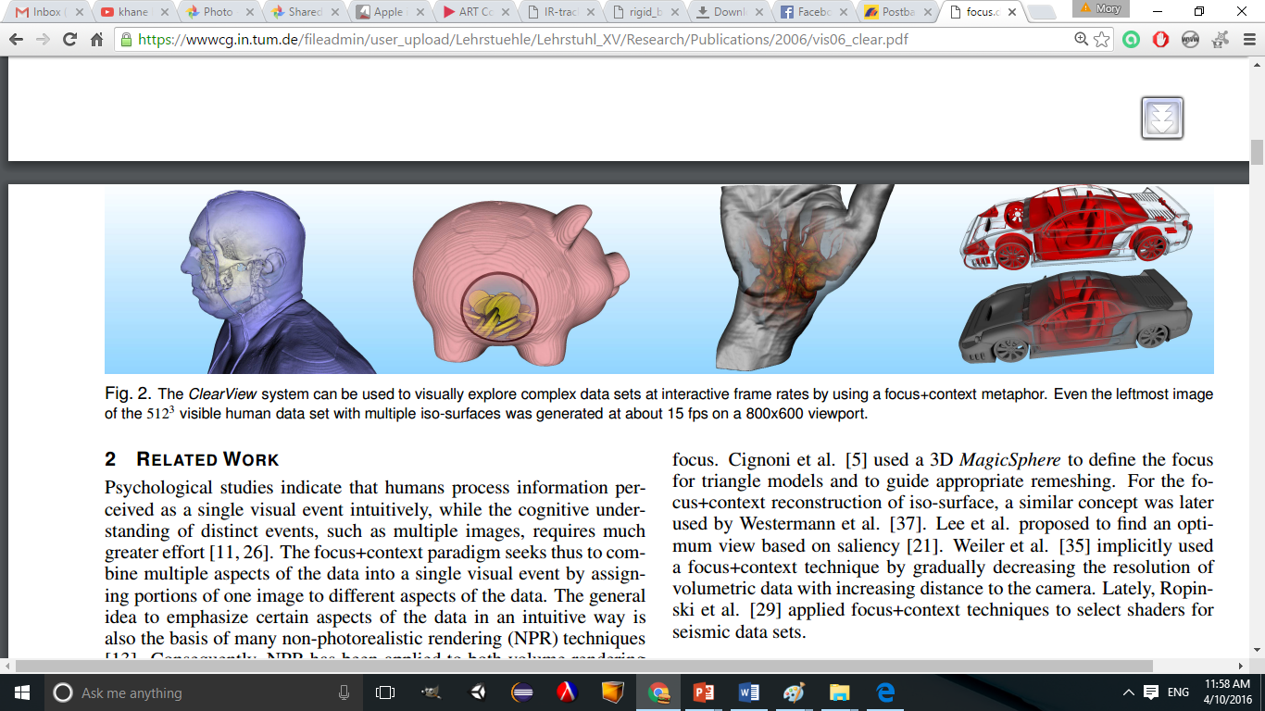
Future Works
ClearView Technique to focus on a specific part of dataset

Slide 24
Vielen Dank für Ihre Aufmerksamkeit!
Prof. Dr.-Ing. Dipl.-Wi.-Ing. Willibald A. Günthner
Technische Universität München fml - Lehrstuhl für Fördertechnik Materialfluss Logistik
Boltzmannstr. 15
85748 Garching
Tel +49.89.289.15921 Fax +49.89.289.15922 E-Mail: kontakt@fml.mw.tum.de

